Slide 1

MACHINE LEARNING
project’s presentation
Presented by : Seemal Mustafa
2023-BS-AI-013

Slide 2


LINEAR REGRESSION
Linear Regression on Cellphone Dataset
Project Overview:
This project analyzes a cellphone dataset to predict a target variable (likely "price") using linear regression. The workflow includes data cleaning, preprocessing, and model evaluation.

Slide 3
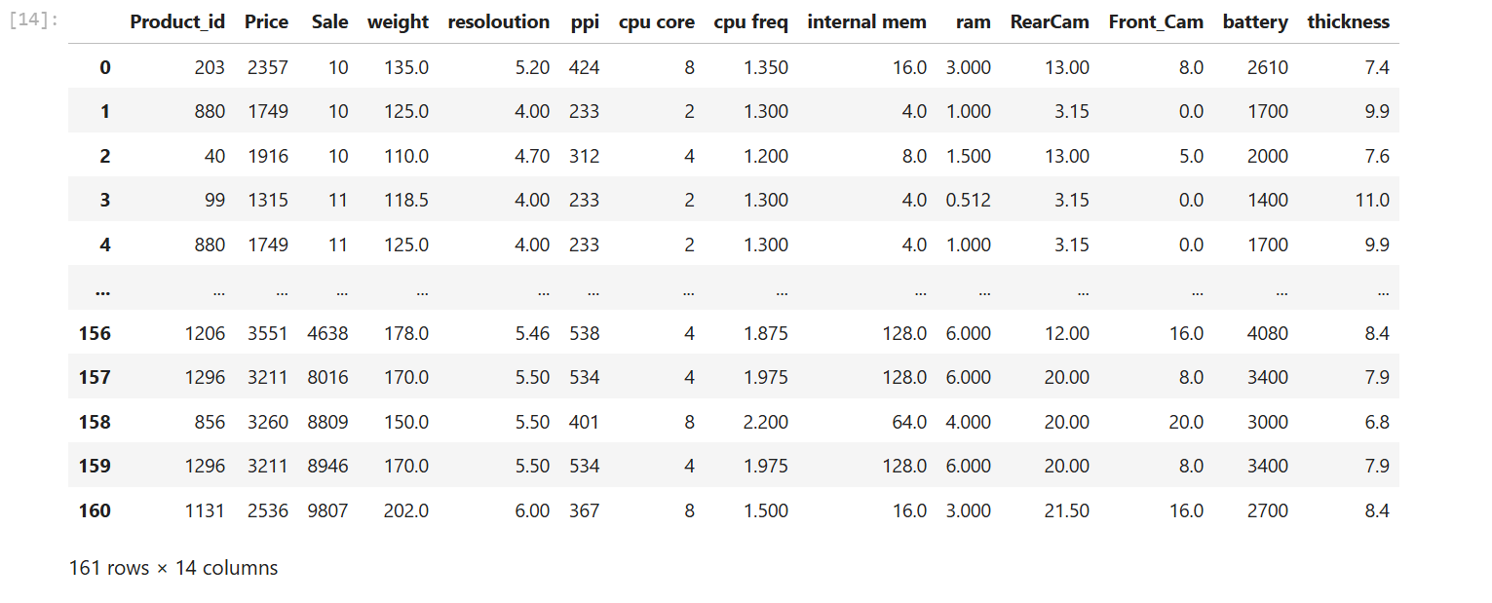
DATASET
DATASET PROJECT 1:
•Source: Cellphone.csv (local file).
•Features: Mixed numerical and categorical data.
•Target: Assumed to be "price" (referenced in code).

Slide 4




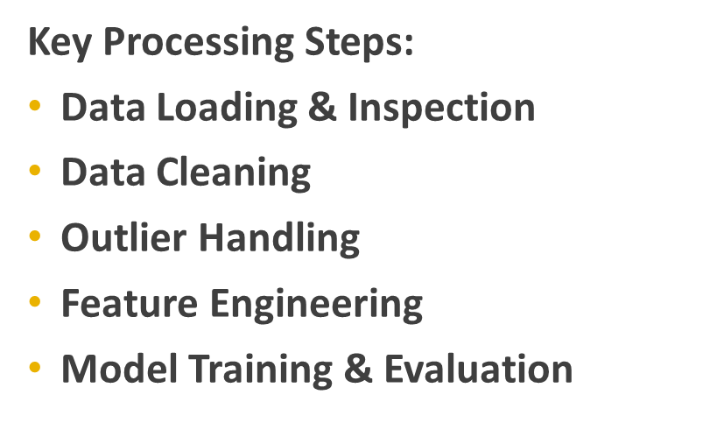

PROCESSING STEPS

Slide 5
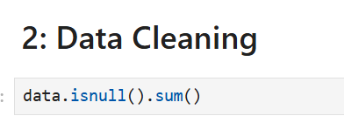


MODELING AND EVALUATION
•Model: Linear Regression using sklearn.
•Data Split: 70% training, 30% testing.
•Metrics: MSE, MAE, RMSE to measure error
•R² Score to assess model fit

Slide 6
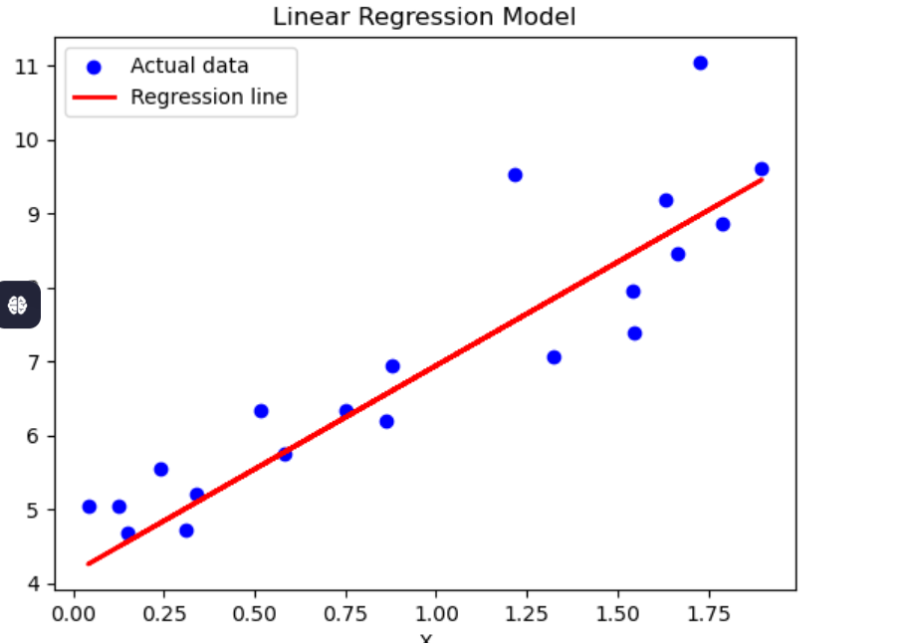
KEY FINDINGS
Key Findings
•The model closely fit the data (y = 4 + 3X + noise)
•Good performance indicated by low error and high R²
•Proper handling of missing values, duplicates, and outliers improved results

Slide 7


CONCLUSION
Conclusion
A clean, well-preprocessed dataset led to an accurate linear regression model. The strong R² confirms the model's reliability for predicting continuous values.

Slide 8
Thank you very much!

